Slide 1
COM5507
Data-oriented employment advice for the graduate of Communication and Media
MAO, Xianghua 56790971
LI Weijia 56924596
ZHANG Xiaoguang 56832260
Huang Huanhuan 56316413
Instructor: Dr. LIU, Xiaofan

Slide 2
01
Introduction
Content
02
Method
03
Results

Slide 3
01
Introduction
Background and research questions

Slide 4

Background
·The COM students are going to face the challenge to find proper jobs very soon.
·Explore the information about occupations our graduates usually take on (advertising, public relation, product manager, business analysis, user research and content operation)
·Give a reference to the students.
Introduction

Slide 5

Research Questions
1
For each job, which cities provide the largest number
(for number>10)?
2
For cities in RQ1, how much salaries they provide for corresponding job?
Introduction
3
For each job, which companies provide the most salaries?
4
Is there any significant difference in salary among different positions?

Slide 6
02
Method
Data acquisition and pre-processing

Slide 7
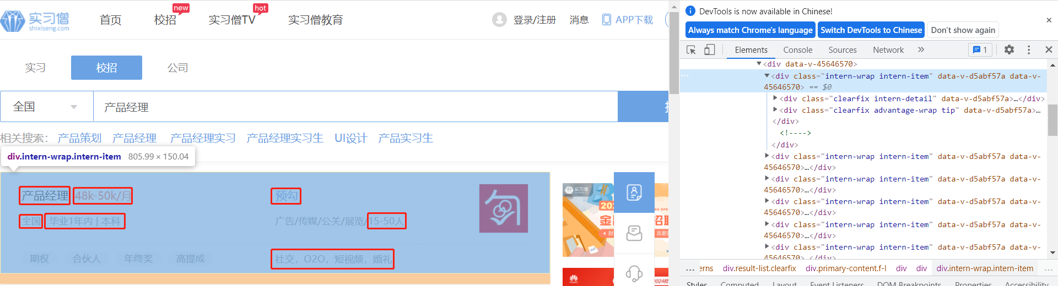
The data acquisition process
Data source
shixiseng focuses on internship, a campus recruitment platform for school recruitment.
baseurl="https://resume.shixiseng.com/interns?page="
for i in range(0,10):
url=baseurl+str(i)+'&type=school&keyword='
Measurements or variables
Method
job title
salary
details page URL
company name
identity requirements
company scale
academic requirements
work place
company introduction
Notes:
shixiseng focuses on internship, a campus recruitment platform for school recruitment. Therefore, I think it will be of great help to us students in school.
the baseurl is like that, and i use for loop to get 10 pages for each post.
I scraped the job title, company name, work place, salary, identity requirements, academic requirements, company scale, company introduction and details page URL.

Slide 8
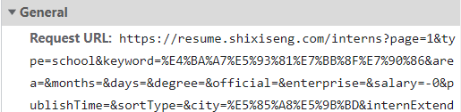
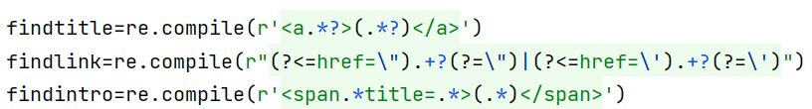
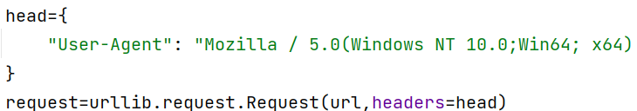
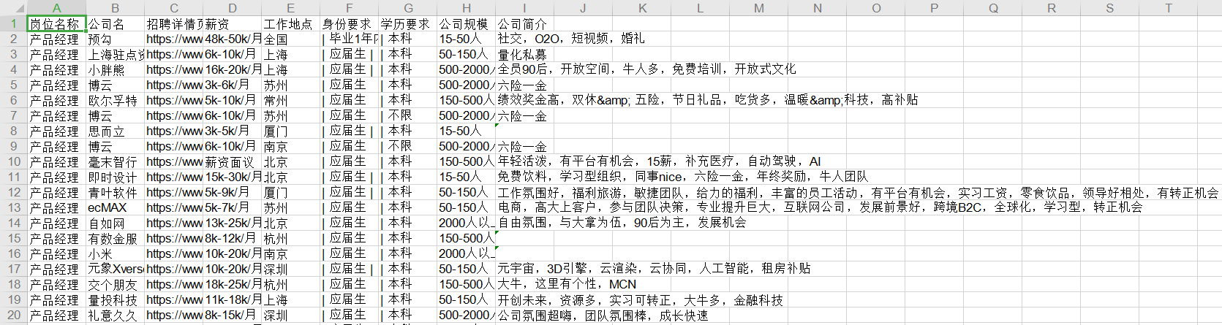
The data acquisition process
Procedure
major packages:
bs4.BeautifulSoup, re, urllib.request, xlwt
major difficulties
Analysis the URLs structure
Use regular expression to match exact results
Access to the web page is denied
scraped results
data format- excel
Method
Notes:
i have used four packages including beautifulsoup, regular expression, request, xlwt.
the major difficulties to scrape the page are
F12-Network-Headers-General-Request URL
Most time-consuming time
Add user-agent

Slide 9
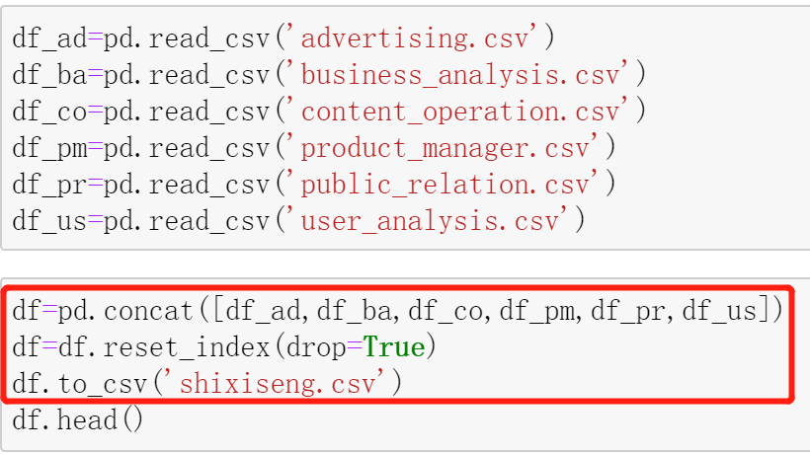
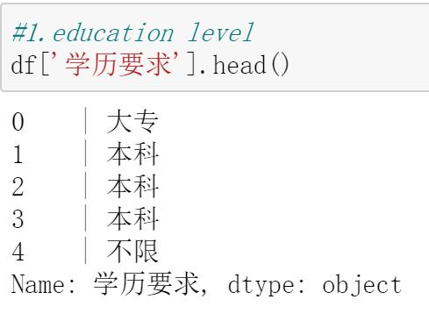
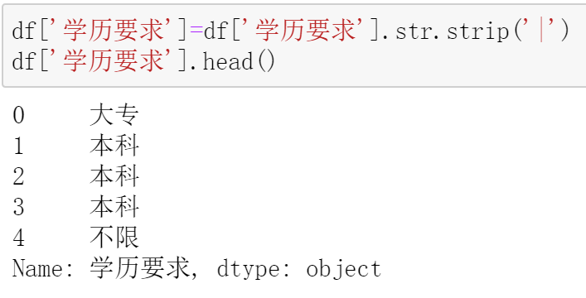
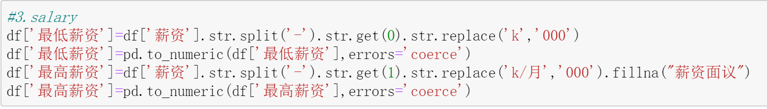
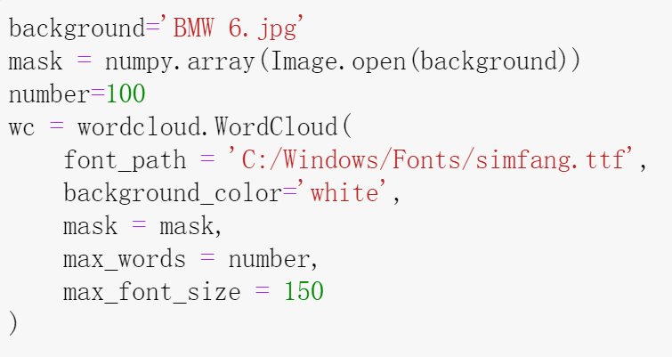
Data pre-processing
For data concatenate:
cancat
For text processing:
strip/replace
Method
For numeric value processing:
split+replace+to_numeric
For visualization:
plot & wordcloud
Notes:
For data join, We use the concat function to link the six data frames of different positions we crawled to and save them in csv format.
For text processing, first, We use the strip and replace function to remove redundant bar symbols
For numeric value processing, we first split hyphen to divide minimum and maximum salary and then replace useless characters with 000, last, we convert them into float type respectively.
For data visualization, we using the plot function to draw bar plots and import wordcloud package to depict wordcloud.

Slide 10
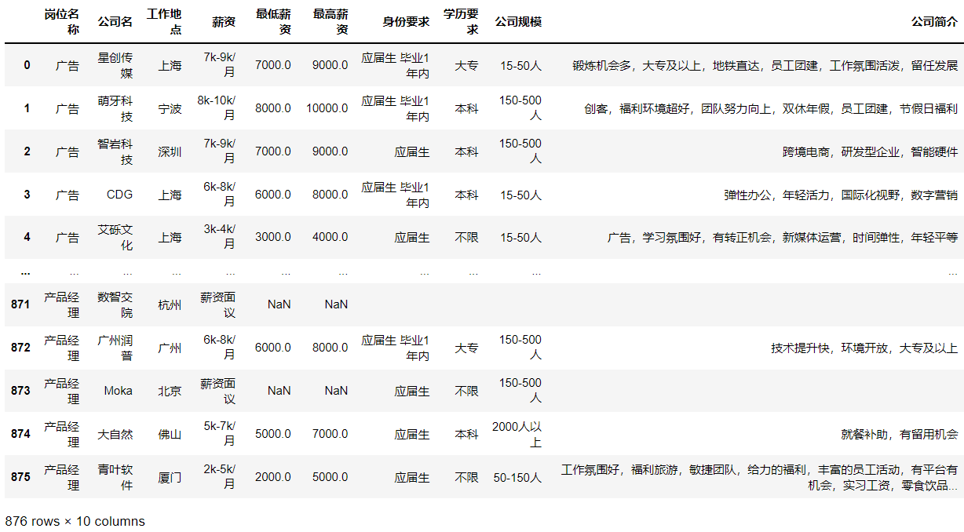
Cleaned data
Method
Notes:
As you can see, there are 876 rows of data after eliminating duplication. So, this is the cleaned data ready to be analyzed.

Slide 11
03
Result
Notes:
Let’s talk about the result of our project.

Slide 12
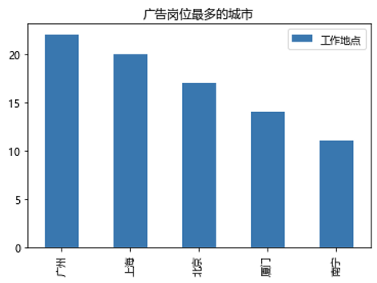
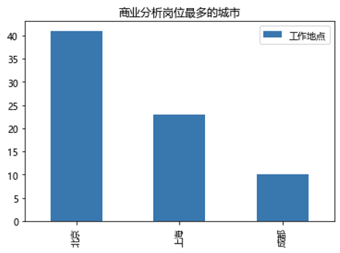
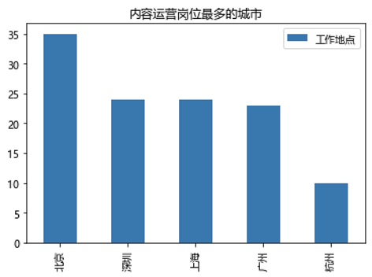
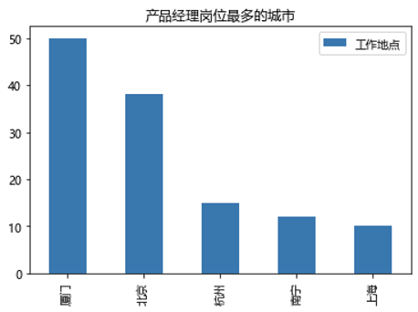
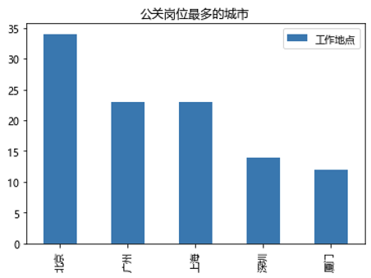
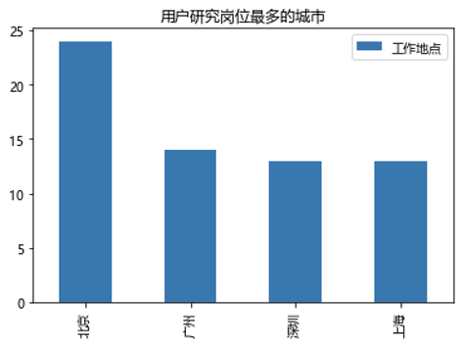
For each job, which cities provide the largest number(for number>10)?
Advertising
Business analysis
Content operation
Product manager
Public relation
User research
Results
The largest number of jobs in those posts occurs in Beijing, Guangzhou, and Xiamen.
Only 3 cities provide over 10 business analysis positions, and 4 cities provide over 10 user research positions.
Notes:
For the first research question, beijing has the largest number of business analysis, content operation, public relation and user research, while xiamen has the largest number of product manager, guangzhou has largest number of advertising. what should be noticed is that only 3 cities provide over 10 business analysis positions, and 4 cities provide over 10 user research positions.

Slide 13
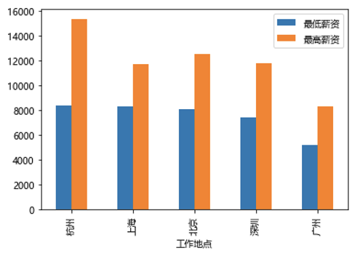
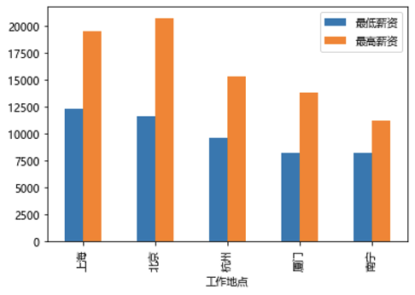
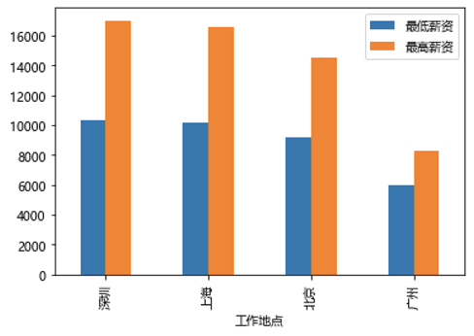
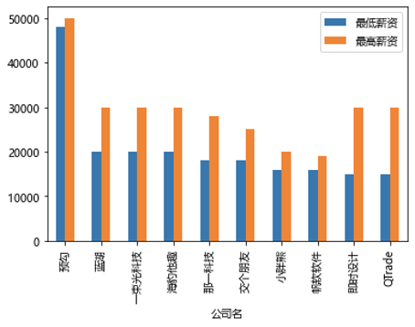
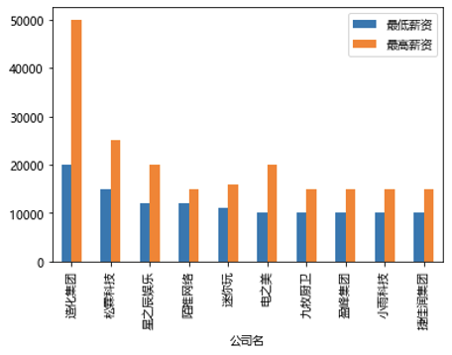
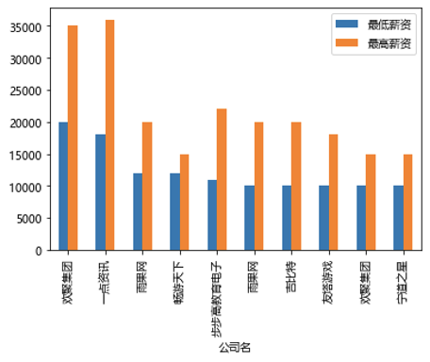
For cities in RQ1, how much salaries they provide for corresponding job?
Content operation
Product
manager
User
research
For each job, which companies provide the most salaries?​
Product manager
Public Relation
Advertising
Results
Notes:
For the second research question, I analyze the minimum and maximum salaries of different positions in the cities mentioned before. Due to the limit of the space, i will only show half of the result here. Considering the actual situation, the minimum salary is often close to the actual salary, so it is more statistically significant. Salary is sorted by the minimum salary first, and then by the maximum salary. As the first picture shows, Hangzhou have the highest minimum salaries for content operation. Therefore, if you prefer to find a high-salary content operation job, Hangzhou may be a better choice.
For the third research quesition, we analyze the top 10 companies who provide the highest salary for each job. i will only show some of the results here too. Let's take product manager as an example, Yugou provides the highest minimum salary, which is about 48k. Those companies shown above may be our target companies when looking for a job.

Slide 14
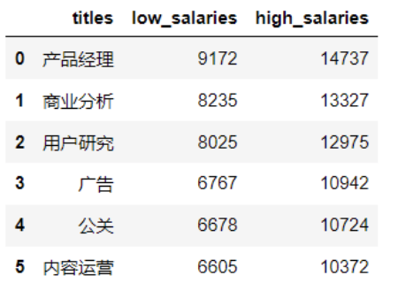

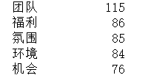
Word cloud for company introduction
Is there any significant difference in salary among different positions?
product manager
business analysis
user research
advertising
public relation
content operation
Results
IV: job position DV: minimum salaries
Team
Welfare
Atmosphere
Environment
Chance
IV: job position DV: maximum salaries
In the ANOVA analysis, both p-values <0.05
there is significant difference
Notes:
For the last research question, i compare the average maximum and minimum salary of different positions.
The highest minimum salary is product manager, which is over 9k; the lowest one is content operation, which is over 6k.
The highest maximum salary is product manager too, which is over 14k; content operation has lowest maximum salary, but still over10k.
i did one way anova analysis twice for different positions. the first independent varible is job position, the dependent varible is minumum salaries.
the second independt varible is job position, the dependent varible is maximum salaries. the results are shown above.
Since those p-values are all much smaller than 0.05, the salary difference among different positions are significant. From the perspective of salary alone, product manager is the most worthwhile position for us to try. Finally, i analyzed the word frequency of the company introduction and create the word cloud. The five most frequently occurring words are team, welfare, atmosphere, environment, and chance, which indicates company prefer to use these words when attracting graduates.

Slide 15
Q&A

